Slide 1
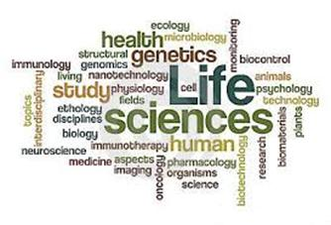
BT1010 Introduction to Life Sciences
Lecture 3: Biomolecules_Nucleic Acids, DNA-Based Information Technologies, Cloning
29/10/2025
Course Instructor:
Dr. Gunjan Mehta, Ph.D.
Assistant Professor
Department of Biotechnology
IIT Hyderabad
(M.) +91 70168 96886 Email: gunjanmehta@bt.iith.ac.in

Slide 2
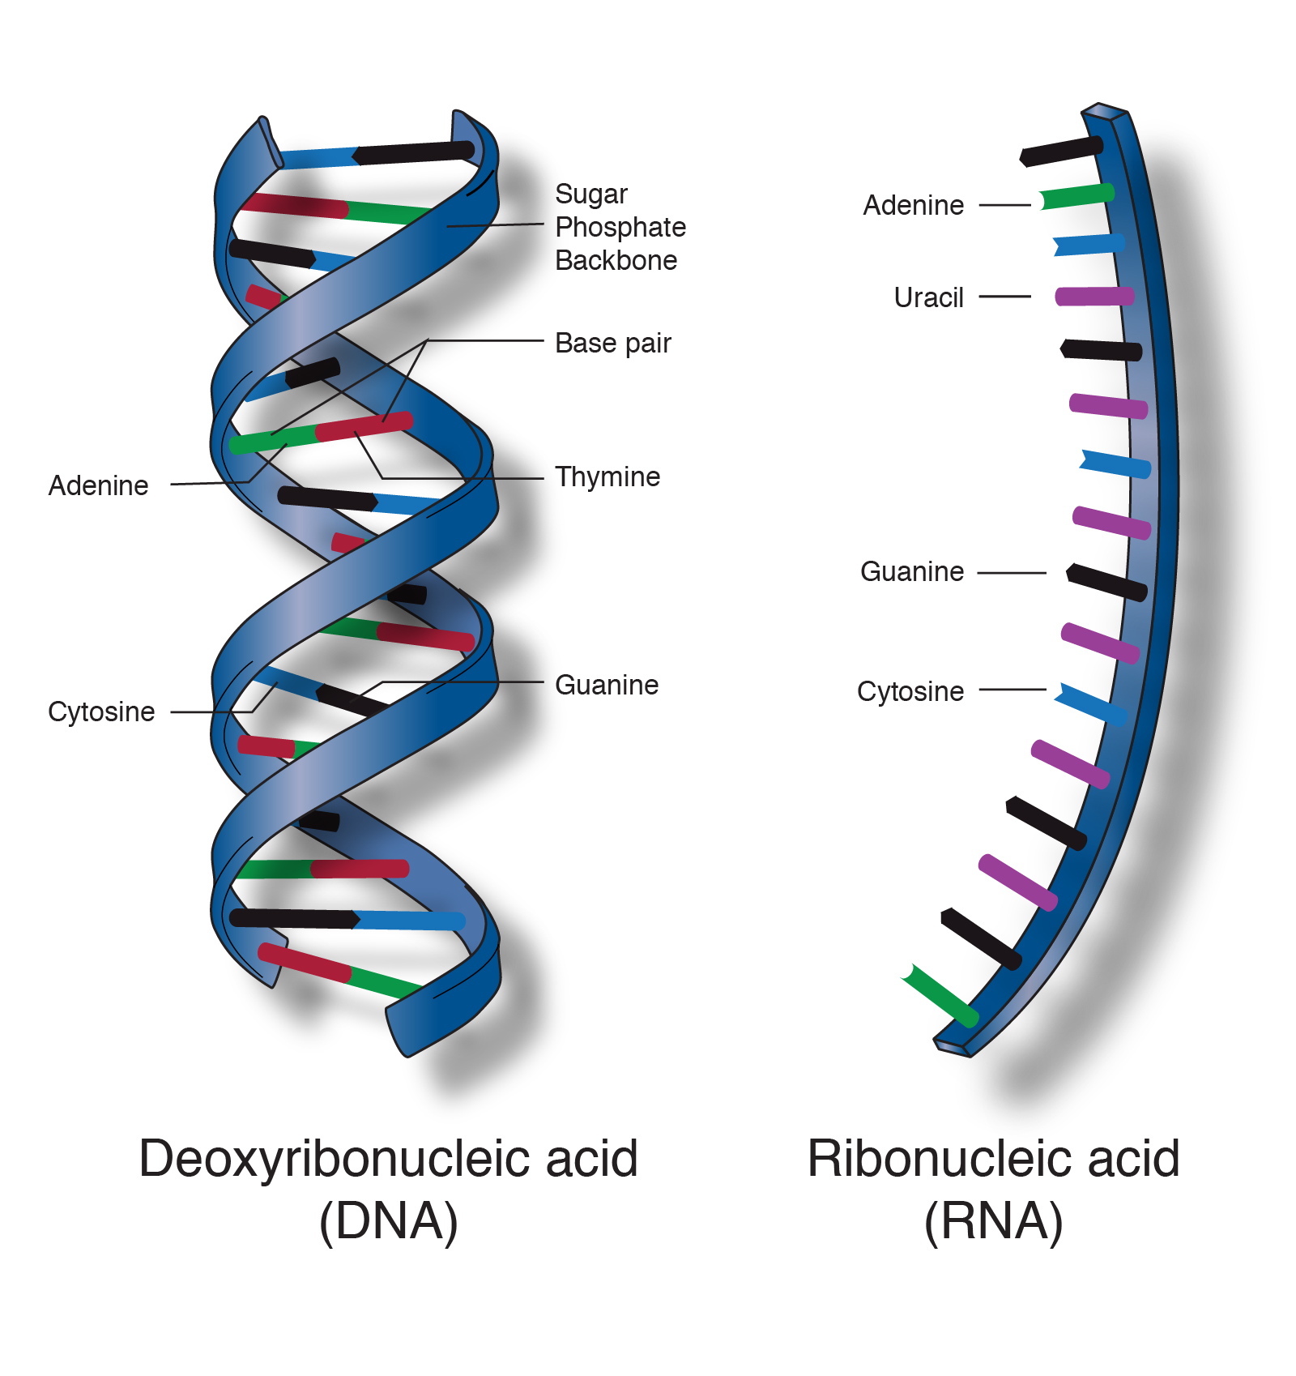
Nucleic Acids
See how DNA and proteins work together:
https://www.youtube.com/watch?v=7Hk9jct2ozY&t=67s
Genetic material

Slide 3
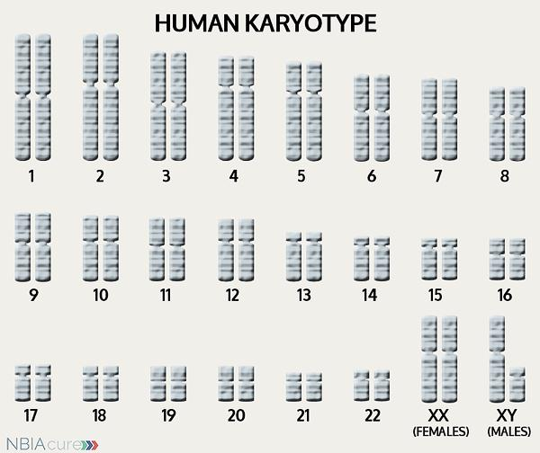

Why do we look similar to our parents or siblings?
From father
From mother
Genetic Inheritance
Human Chromosomes

Slide 4
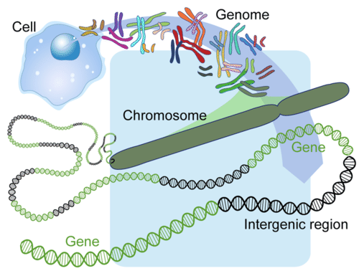
What is the difference between a DNA, Gene, Chromosome and Genome?

Slide 5
Introduction to Nucleic Acids
DNA: Deoxyribonucleic Acid
RNA: Ribonucleic Acid
Nucleotides are the building blocks of nucleic acids.
The amino acid sequences of proteins are specified by a nucleotide sequence in the cell’s DNA.

Slide 6
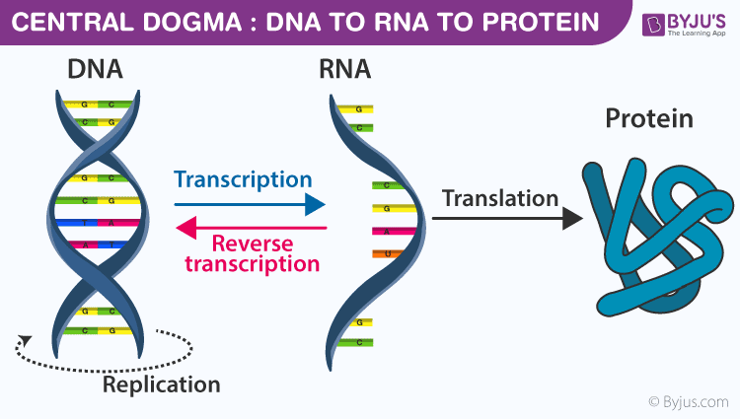
Central Dogma of Molecular Biology

Slide 7
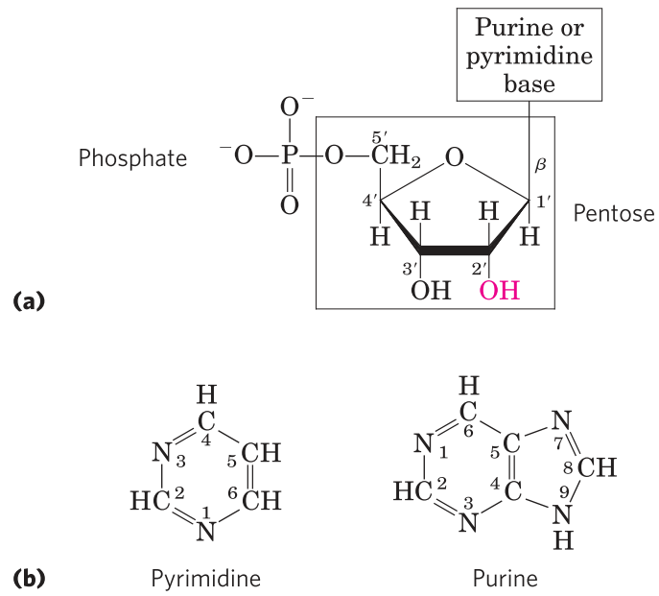
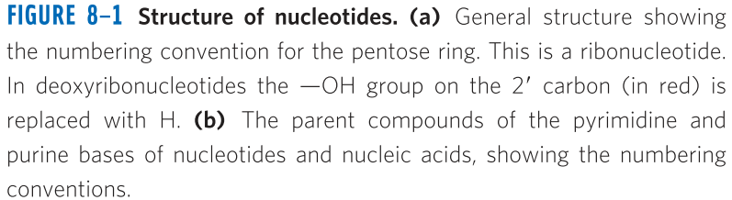
Building blocks of the nucleic acids (DNA and RNA)
Nucleotides have three characteristic components: 1) a nitrogenous base, 2) a pentose, 3) one or more phosphates.
Structure of nucleotides
The nitrogenous bases are derivatives of two parent compounds, pyrimidine and purine.

Slide 8
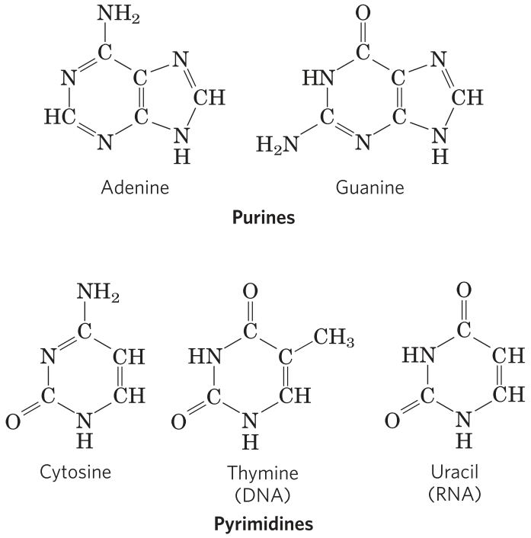
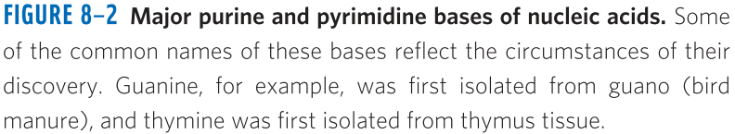
Major purine and pyrimidine bases of nucleic acids

Slide 9
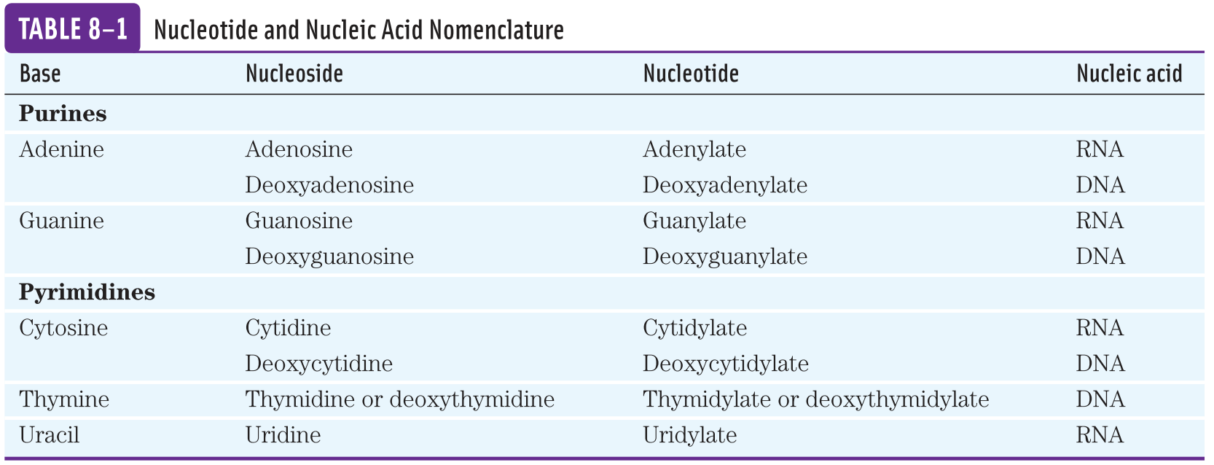
A nucleotide without a phosphate group is called a nucleoside.

Slide 10
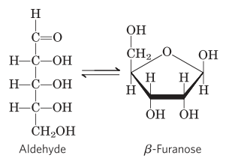
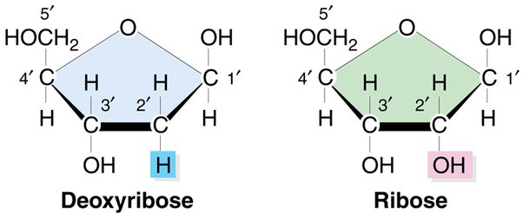
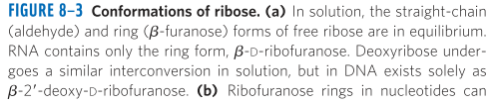
Types of pentose sugars
Nucleic acids have two kinds of pentoses.
DNA contains 2’-deoxy-D-ribose
RNA contains D-ribose

Slide 11
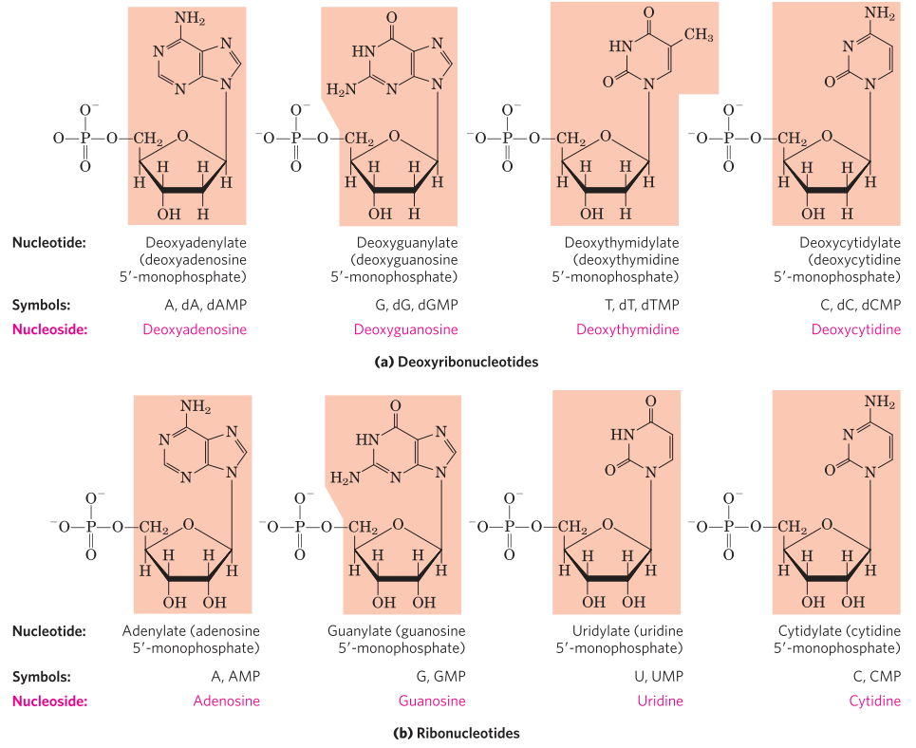
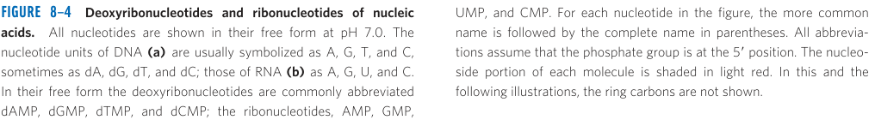
Deoxyribonucleotides and ribonucleotides of nucleic acids

Slide 12
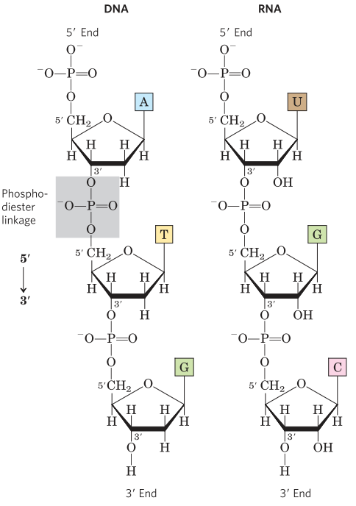
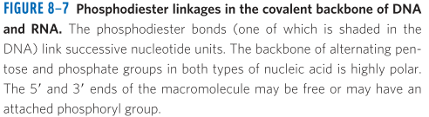
Phosphodiester bonds link successive nucleotides in nucleic acids
The successive nucleotides of both DNA and RNA are covalently linked through phosphate-group “bridges”, in which the 5’-phosphate group of one nucleotide is joined to the 3’-hydroxyl group of the next nucleotide, creating a phosphodiester linkage.

Slide 13
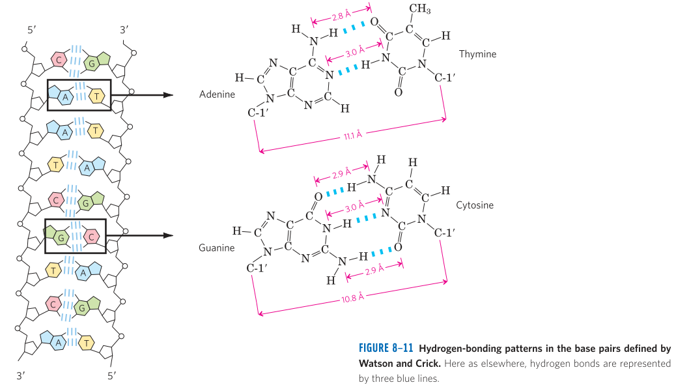
Hydrogen-bonding patterns in the base pairs

Slide 14

History and Discovery of DNA
DNA was first isolated and characterized by Friedrich Miescher in 1868. He called the phosphorous-containing substance “nuclein”.
In 1940, Avery, MacLeod and McCarty found that the DNA extracted from a virulent (disease-causing) strain of the bacterium Streptococcus pneumoniae and injected into a nonvirulent strain transformed the nonvirulent strain into a virulent strain.
In 1952, Hershey and Chase studied the infection of bacterial cells by a virus (bacteriophage) with radioactively labeled DNA or protein confirmed that DNA, not protein, is the genetic material.
In 1940, Erwin Chargaff provided following conclusions: (Chargaff’s Rules)
The base composition of DNA generally varies from one species to another.
DNA specimens isolated from different tissues of the same species have the same base composition.
The base composition of DNA in a given species does not change with an organisms’s age, nutritional status, or changing environment.
In all cellular DNA, A=T and G=C. (A+G = T+C)

Slide 15
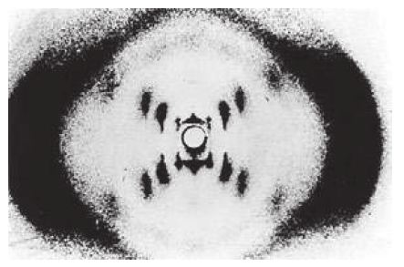
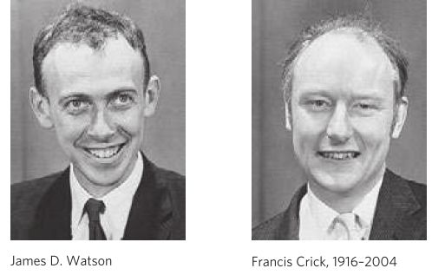
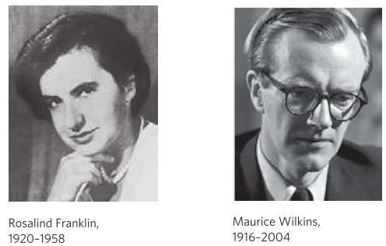
History and Discovery of DNA
In 1950s, Rosalin Franklin and Maurice Wilkins used X-Ray diffraction to analyze DNA fiber.
In 1953, James Watson and Francis Crick relied on this accumulated information about DNA and postulated a 3D structure of DNA.
In 1962, Watson, Crick and Wilkins were awarded the Nobel Prize in Physiology or Medicine.
X-Ray diffraction pattern of DNA fibers
1928-xxxx

Slide 16
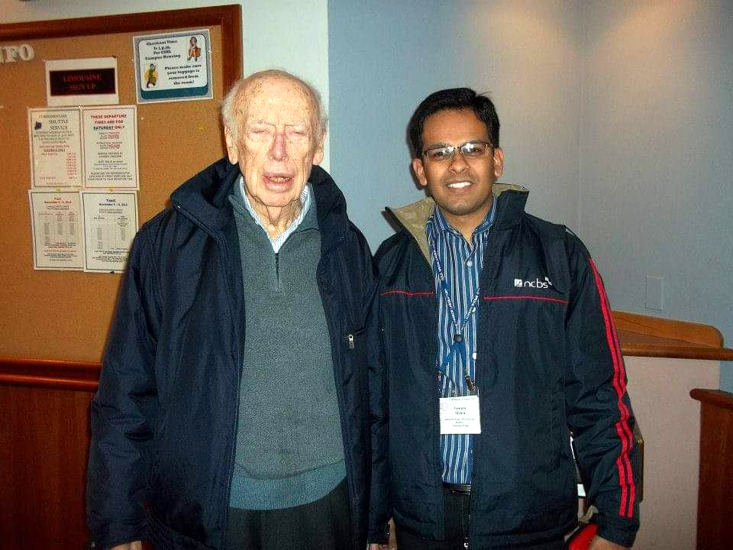
At Cold Spring Harbor Laboratory, New York, 2013
James Watson

Slide 17
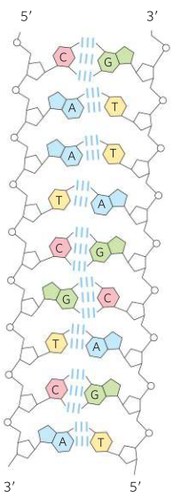
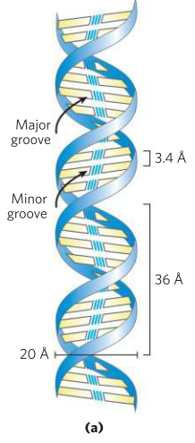
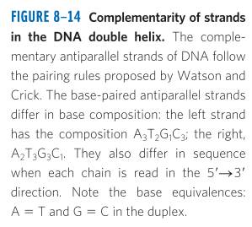
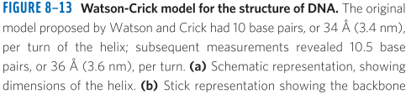
Structure of DNA
It consists of two helical DNA chains wound around the same axis to form a right-handed double helix.
The hydrophilic backbones of alternating deoxyribose and phosphate groups are on the outside of the double helix, facing the surrounding water.
The offset pairing of the two strands creates a major groove and minor groove on the surface of the duplex.
Three hydrogen bonds form between G and C, whereas only two hydrogen bonds form between A and T.
Both strands of DNA are in antiparallel orientation.
Vertically stacked bases are 3.4 A apart.

Slide 18
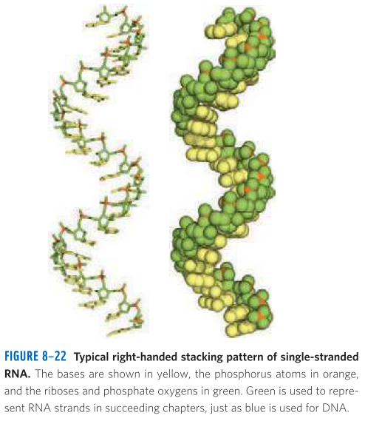
RNA (Ribonucleic Acid)
RNA is the second major form of nucleic acid in cells.
RNA carries genetic information from DNA to the protein biosynthetic machinery of the ribosome.
By the process of transcription, RNA is synthesized from the DNA template.
Three types of RNAs involved in protein synthesis:
mRNA: Messenger RNA
tRNA: Transfer RNA
rRNA: Ribosomal RNA

Slide 19
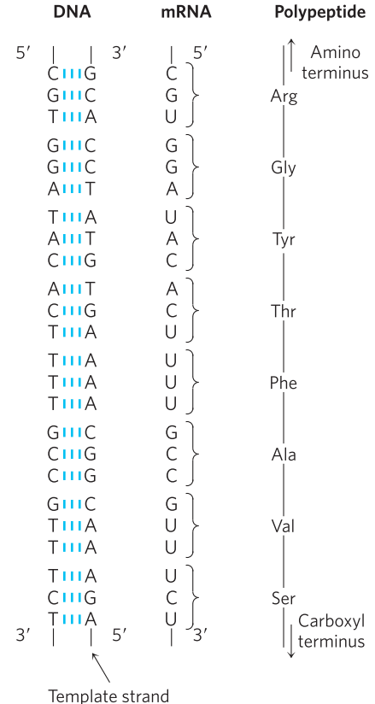
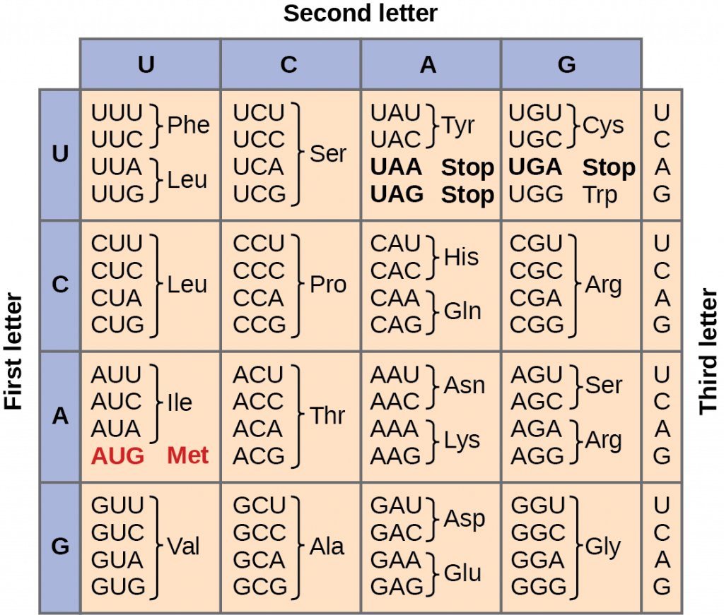
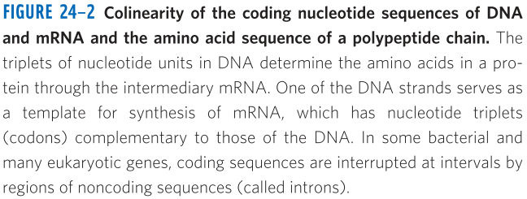
How the polypeptide/protein chain is synthesized based on the DNA and RNA sequences?
Amino acid codon table
Transcription
Translation

Slide 20
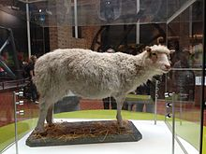
DNA-based information technologies_Cloning
Cloning is a technique scientists use to make exact genetic copies of living organisms.
Genes, cells, tissues and even whole animal can be cloned.
Dolly the sheep: was the first mammal to have been successfully cloned from an adult somatic cell in 1996 in Scotland.
Dolly died at the age of 6 years, whereas the regular lifespan of sheep is ~12 to 13 years.
Dolly was euthanized at the age of 6 years due to liver cancer and arthritis.
Dolly: 5 July 1996 – 14 February 2003
National Museum of Scotland

Slide 21
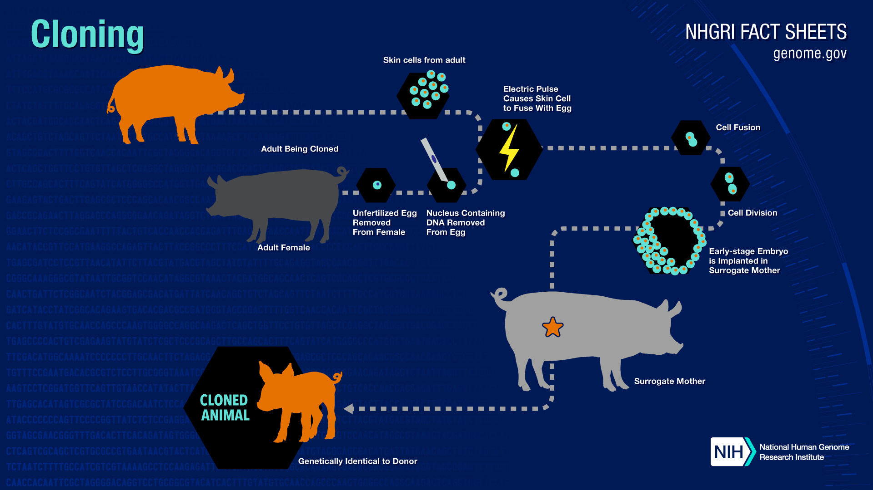

Slide 22
Ethical Issues of Cloning Animals
There are a variety of ethical concerns regarding the possibilities of cloning, especially human cloning.
While many views are religious in origin, there are also secular perspectives.
Advocates support development of therapeutic cloning to generate tissues and whole organs to treat patients.
Advocates for reproductive cloning believe that patients who cannot reproduce should have access to the technology.
Opponents of cloning have concerns that the technology can be prone to abuse and how cloned individuals could integrate with families and with society at large.
Religious groups believes that the technology can be misused as usurping “God’s place”. Also this technology uses embryos, so it destroys human life. Other religious groups support therapeutic cloning’s potential life-saving benefits.
Cloning of animals is opposed by animal-groups due to the number of cloned animals that suffer from malformations before they die.

Slide 23
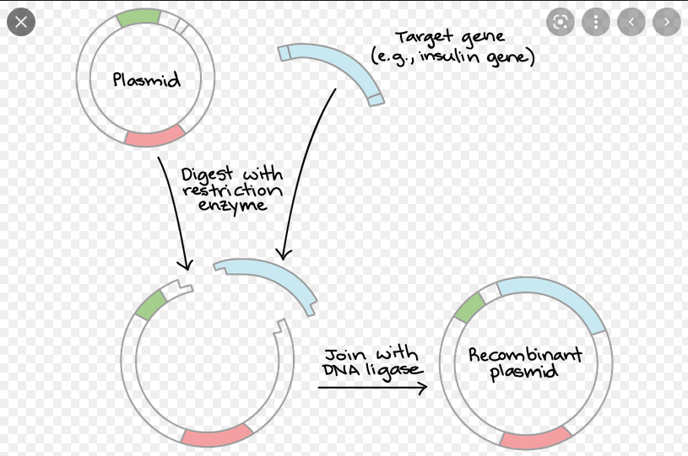
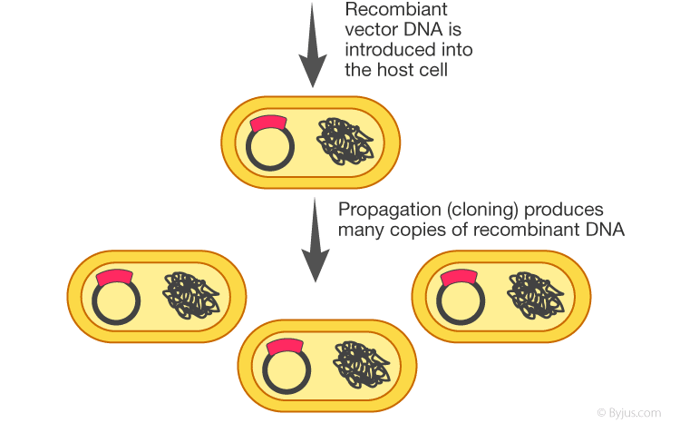
DNA Cloning / Molecular Cloning / Recombinant DNA Technology / Genetic Engineering
DNA cloning is a molecular biology technique that makes many identical copies of a piece of DNA, such as a gene.
In a typical DNA cloning procedure, the gene (perhaps a gene for a medically important human protein) is first inserted into a circular piece of DNA called a plasmid. The insertion is done using enzymes that “cut and paste” DNA, and it produces a molecule of recombinant DNA.
Cloning of DNA entails five general procedures:
Cutting target DNA at precise locations. (Sequence-specific endonucleases) provide the necessary molecular scissors.
Selecting a small carrier DNA capable of self-replication. These DNAs are called cloning vectors or plasmids.
Joining two DNA fragments covalently. DNA ligase is an enzyme that links the cloning vector and the DNA to be cloned. The resultant DNA molecule is known as recombinant DNA.
Moving recombinant DNA from the test tube to a host cell that will provide the enzymatic machinery for DNA replication.
Selecting host cells that contain recombinant DNA.
The methods used to accomplish these and related tasks are collectively referred to as recombinant DNA technology or Genetic engineering.

Slide 24
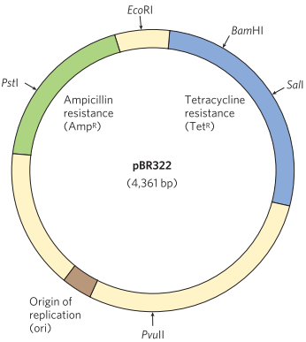
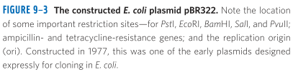
Cloning vectors (plasmids) allow amplification of inserted DNA segments
Plasmids: A plasmid is a circular DNA molecule that replicates separately from the host chromosome.
Their size ranges from 5000 to 400000 bp.
To survive in the host cell, plasmids incorporate several specialized sequences that enable them to make use of the cell’s resources for their own replication and gene expression.
pBR322, constructed in 1977, is a good example of a plasmid with features
useful in almost all cloning vectors.
Origin of replication (ori), a sequence where replication is initiated by
cellular enzymes. An associated regulatory system is present that limits
replication to maintain pBR322 at a level of 10 to 20 copies per cell.
(Two different plasmids cannot function in the same cell if they use the same ori.)
Antibiotic resistance genes Tet^{R} (Tetracycline Resistance) and Amp^{R}
(Ampicillin Resistance) allow selection of cells that contain the intact
plasmid or a recombinant version of the plasmid.
RE sites to be cut and insert foreign DNA.
Small size of the plasmid (4361 bp) facilitates its entry into cells and
the biochemical manipulation of the DNA.

Slide 25
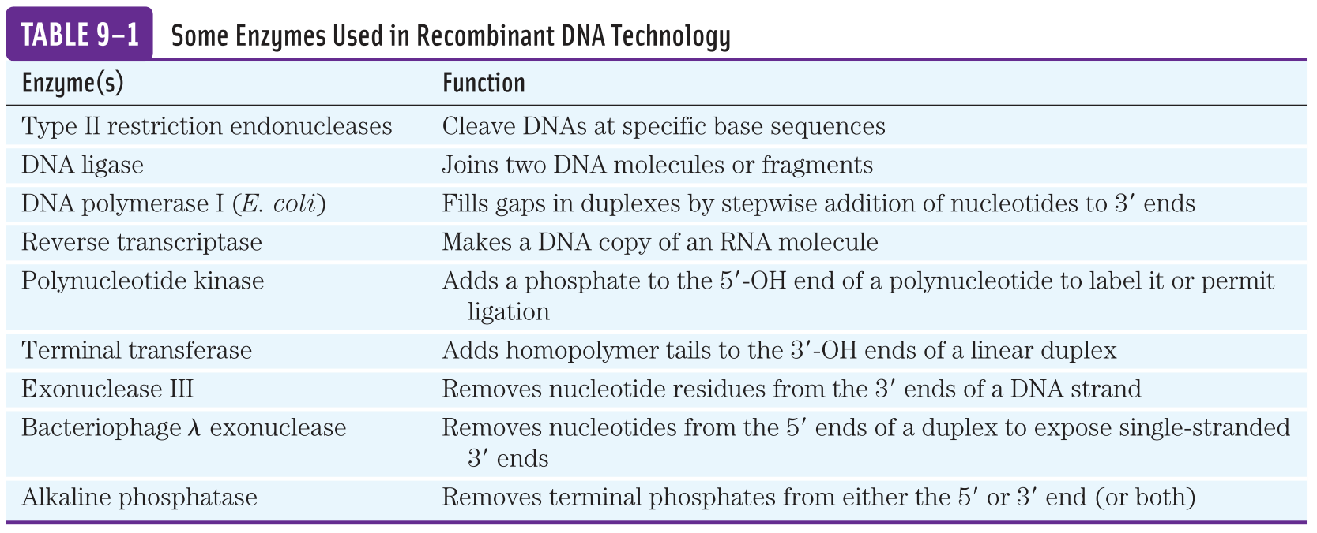

Slide 26
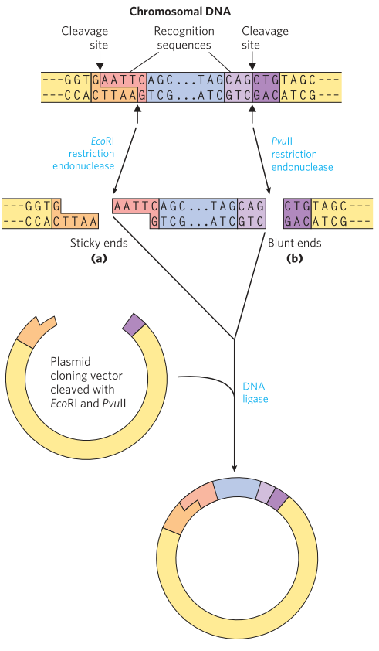
DNA ligase joins the DNA molecule
DNA ligase is used to join two DNA molecules. It forms phosphodiester bonds between the DNA molecules.
A vector (plasmid) digested by EcoRI can be ligated to an insert digested by the same RE. It can not be ligated to an insert digested by BamHI.
Blunt ends can also be ligated, albeit less efficiently.

Slide 27
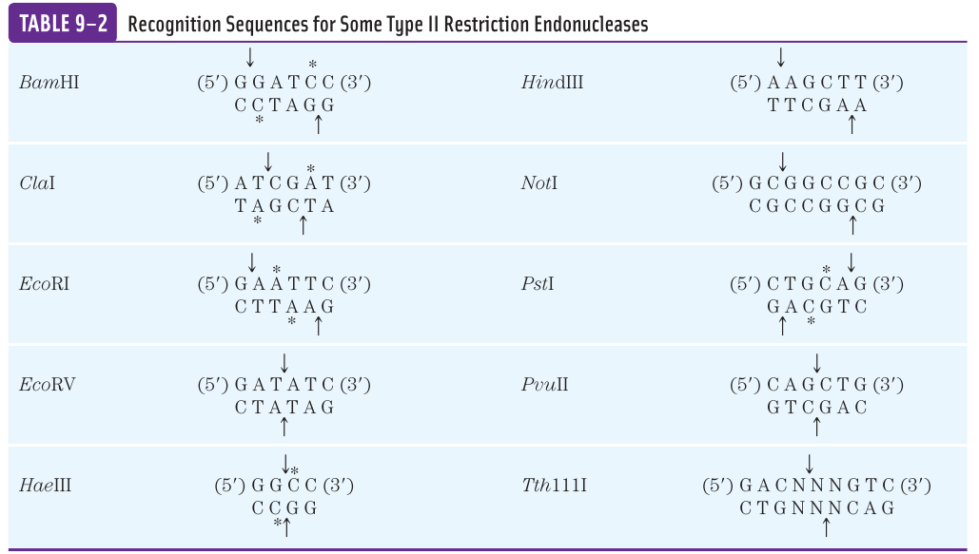
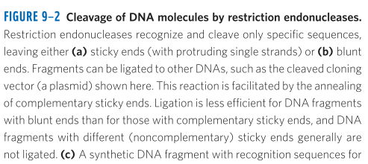
In general, a 6 bp sequence recognized by a RE (such as BamHI) would occur on average once every 4⁶ (4096) bp.
An enzyme that recognize a 4 bp sequence would occur on an average once every 4⁴ (256) bp.

Slide 28
How to introduce plasmids into bacterial cells?
There are two ways:
Transformation:
The bacterial cells (often E. coli) and plasmid DNA are incubated together at 0 ºC in a calcium chloride solution, then subjected to heat shock by rapid shifting the temperature to between 37 ºC and 43 ºC.
Electroporation:
The bacterial cells (often E. coli) are incubated with plasmid DNA are subjected to high-voltage electric pulse. This approach transiently renders the bacterial membrane permeable to large molecules.
Regardless of the approach, relatively few cells take up the plasmid DNA, so a method is needed to identify those cells which contain the plasmid.
Plasmids usually contains one or two selectable markers (such as Tet^{R}, Amp^{R}).

Slide 29
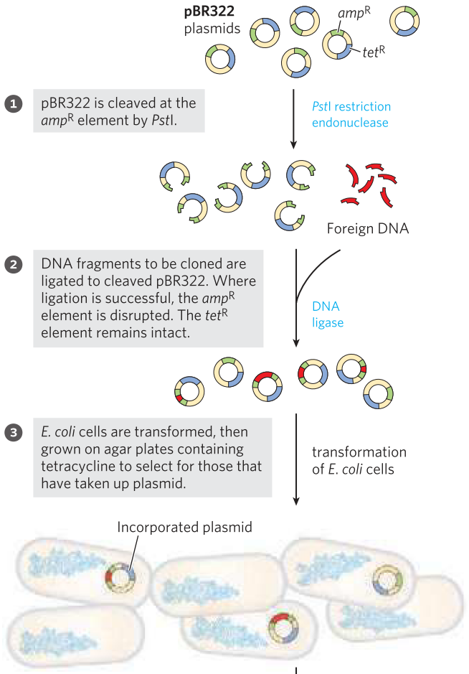
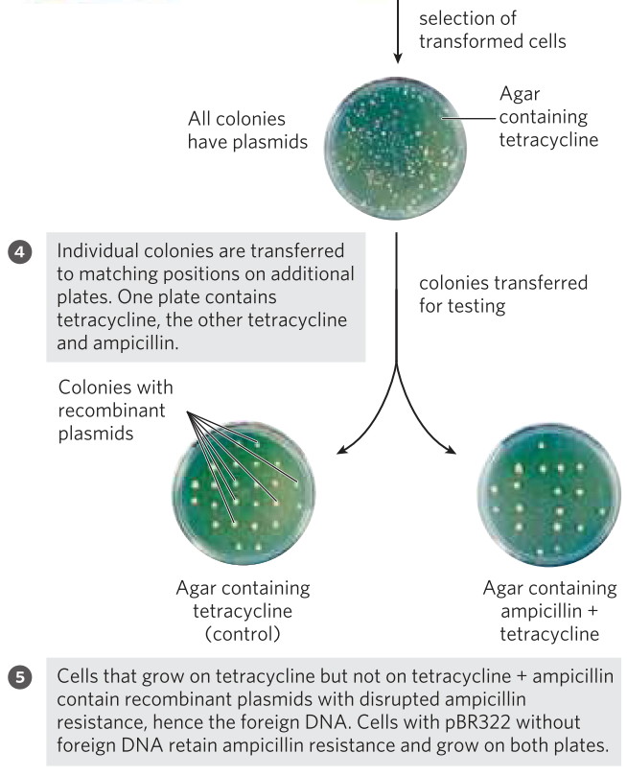
Use of pBR322 to clone foreign DNA in E. coli and identify cells containing it.
A cloning strategy
with pBR322

Slide 30
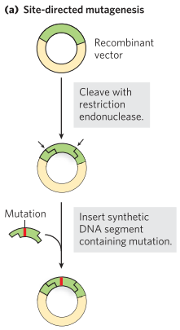
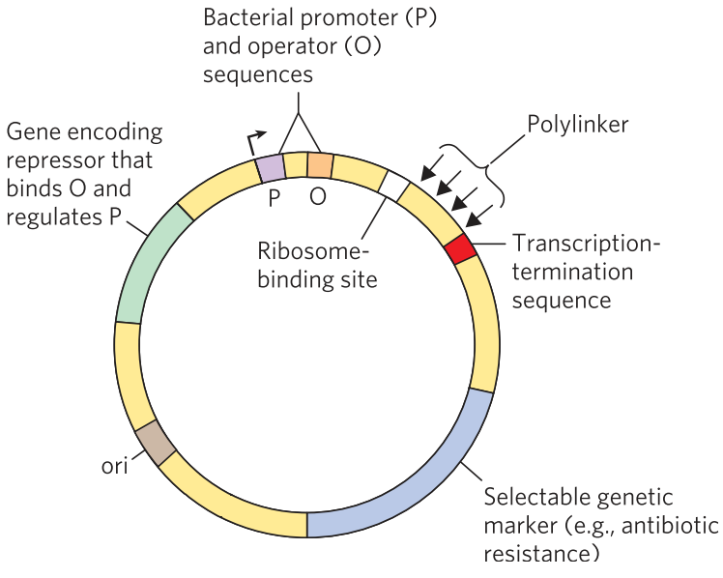
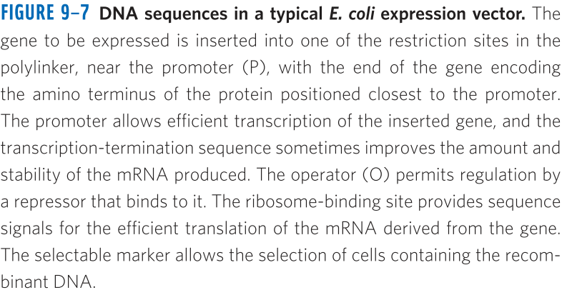
Cloned genes can be expressed to amplify protein production
Frequently, the product of the cloned gene, rather than the gene itself, is of primary interest-particularly when the protein has commercial, therapeutic or research value.
Cloning vectors with the transcription and translation signals needed for the regulated expression of a cloned gene are called expression vectors.
Site-directed mutagenesis can be used to produce a mutant version of the protein.

Slide 31
Further reading
Book: Lehninger: Principles of Biochemistry, 6th edition. ISBN: 1464109621.
Chapter 8: Nucleotides and Nucleic Acids, Page 281-312.
Chapter 9: DNA-Based Information Technologies, Page 313-355.
Next class on 30/10/2025 (Thursday)

Slide 32
Restriction Endonucleases
Restriction endonucleases (RE), also called restriction enzymes, recognize and cleave DNA at specific sequences (recognition sequences or restriction sites) to generate a set of smaller fragments.
REs are found in a wide range of bacterial species. However, in its host cells, REs can’t digest its DNA because of methylation of the DNA bases. This mechanism is known as Restriction Modification System.
Three types of REs: Type I, Type II and Type III
Type I and III are generally large, multisubunit complexes containing both the endonuclease and methylase activities. They require ATP for energy.
Type I REs cleave DNA at random sites that can be more than 1000 bp from the recognition sequences.
Type III REs cleave the DNA about 25 bp from the recognition sequences.
Type II REs cleave the DNA within the recognition sequence itself. They don’t need ATP. The recognition sequences are usually 4 to 6 bp long and they are palindromic.
Some of the Type II REs make staggered cuts on the two DNA strands, leaving two to four nucleotides of one strand unpaired at each resulting end. These unpaired strands are referred to as sticky ends.

Slide 33
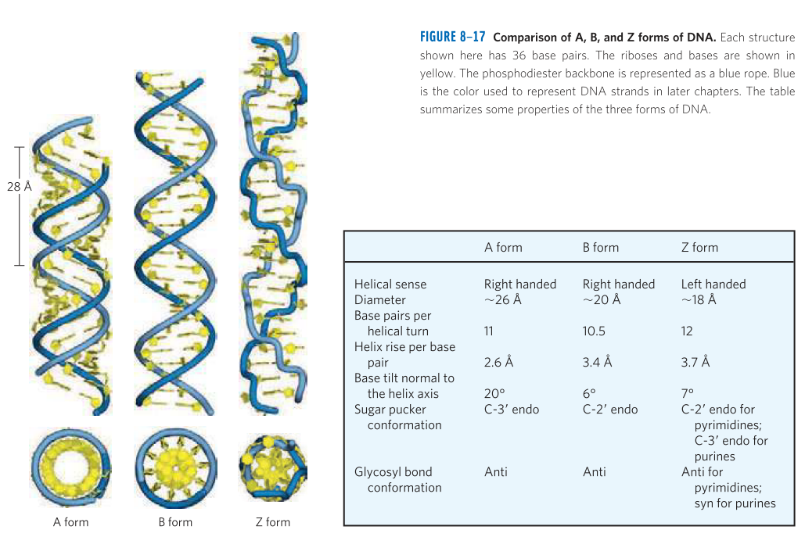
DNA can occur in different three-dimentional forms
The Watson and Crick’s structure is also referred to as the B form and it is the most stable structure under physiological conditions.
A form is preferred in many solutions which are devoid of water.

Slide 34


